Slide 1


SHARED INITIATIVES FOR TRAINING

Slide 2
Meeting with cultural networks, 16 May 2022 Programm of the day:
Round of introduction
Short presentation of SHIFT
Introduction of the SHIFT WP Climate Action
Introduction certificate for cultural networks
Presentation of draft "request for proposal"
List of potential expert organisation
Financial Aspects
Administration and governance
SHARED INITIATIVES FOR TRAINING

Slide 3











SHARED INITIATIVES
FOR TRAINING

Slide 4

THE AIM
TRAIN CULTURAL LEADERS with regards to SDGs.
Enable cultural leaders to implement changes where needed.
Pass on the knowledge to the broader cultural sector.
Notes:
Climate change, gender equality and inclusion of minorities are key challenges for our rapidly changing world. Arts and culture have a recognised role in shaping societies and have the potential to significantly contribute to a better and more sustainable future for all as recognised in the UN Sustainable Development Goals (SDGs). The project SHIFT will provide training initiatives for cultural leaders, working together and creating paths to face such global challenges. Implementing changes where needed and passing on the gained knowledge to leaders and staff members, of cultural networks and the broader cultural sector are key targets of the project.

Slide 5



Notes:
What are the SDGs?
The 2030 Agenda for Sustainable Development, adopted by all United Nations Member States in 2015, provides a shared blueprint for peace and prosperity for people and the planet, now and into the future.
At its heart are the 17 Sustainable Development Goals (SDGs), which are an urgent call for action by all countries - developed and developing - in a global partnership.

Slide 6



OBJECTIVES
Three SDGs have been selected as a starting point to activate and increase the sector‘s awareness

Slide 7





ONLINE Material
DEC. 2019 - Jan. 2022
Research Training Publications
CULTURAL
LEADERSHIP
REDUCING INEQUALITIES
ENVIRONMENTAL SUSTAINABILITY
GENDER
& POWER RELATIONS
Notes:
The partners will produce online manuals and guidelines during these two next years (December 2019-December 2021) on the following themes: Cultural Leadership, Climate Change, Inclusion and Gender & Power-relations.

Slide 8


TOPIC LEADER: TRANS EUROPE HALLES
Annotated Bibliography
Toolkit for Cultural Leaders
Training Tools Compendium
CULTURAL
LEADERSHIP
Notes:
Cultural leadership is one of today’s buzzwords. Yet there is no common understanding on the concept of Cultural Leadership. Today people agree on a community-oriented approach and therefore a shared leadership, which doesn’t have to be neutral and universal, but is aware of its subjectivity and dependence on group identities and values. This new paradigm gives space for a humanistic managerial approach which will benefit to the whole cultural sector.

Slide 9
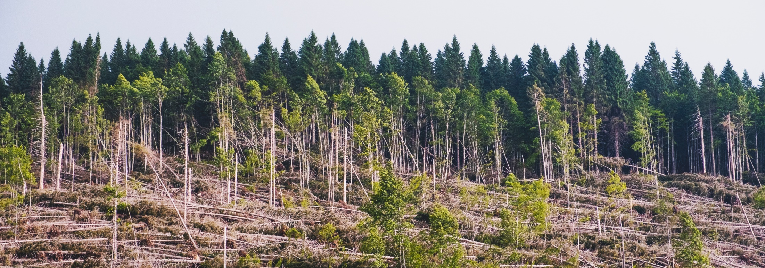
TOPIC LEADER: ELIA
Annotated Bibliography
Eco-Guidelines
Fact Sheets
ENVIRONMENTAL
SUSTAINABILITY
Notes:
Climate change is now affecting every country on every continent. It is disrupting national economies and affecting lives on local, national and global level. This project will provide capacity building for leaders and staff of cultural networks on how to claim a role in the action required to achieve the climate change goals of the UN SDGs. Claiming that role means embedding environmental sustainability into the way we work and collaborate.

Slide 10

TOPIC LEADER: IETM
Annotated Bibliography
Report “#Metoo and the Arts”
Key findings
GENDER
& POWER
RELATIONS
Notes:
The #METOO movement, and other movements and campaigns, have increased the awareness and empowered employees around the globe to report sexual harassment and other inequalities in the workplace. They have also brought to the surface the vulnerability and a lack of effective protection mechanisms of anyone facing power abuse, regardless of age, class and gender. The aim of this foreseen code of conduct and toolkit is to contribute to a lasting impact of this wave of empowerment on professional and societal culture.

Slide 11

TOPIC LEADER: EUROPEAN CHORAL ASSOCIATION
Annotated Bibliography
Handbook
Interviews
REDUCING INEQUALITIES
Notes:
While the topic of inclusion in itself is not new, we realised that there are no general guidelines for cultural networks about how an organisation can adapt its work, its communication and its activities to reach more people in danger of being excluded. These guidelines will be the first document aimed at networks, organisations and institutions active in the field of culture. It will also have a special focus on leaders of these networks and organisations, with the aim of training them and reinforcing their capacity to increase inclusion and accessibility and to reduce inequality in their organisation and its activities.

Slide 12



TOOLS PRODUCED are Fully available for free online:
www.shift-culture.eu
AND THE RESOURCES GATHERED on:
artsmetric.com/project-resources/shift/
Any Questions? Contact us at info@emc-imc.org

