Slide 1


CLIMATE ACTION

Slide 2
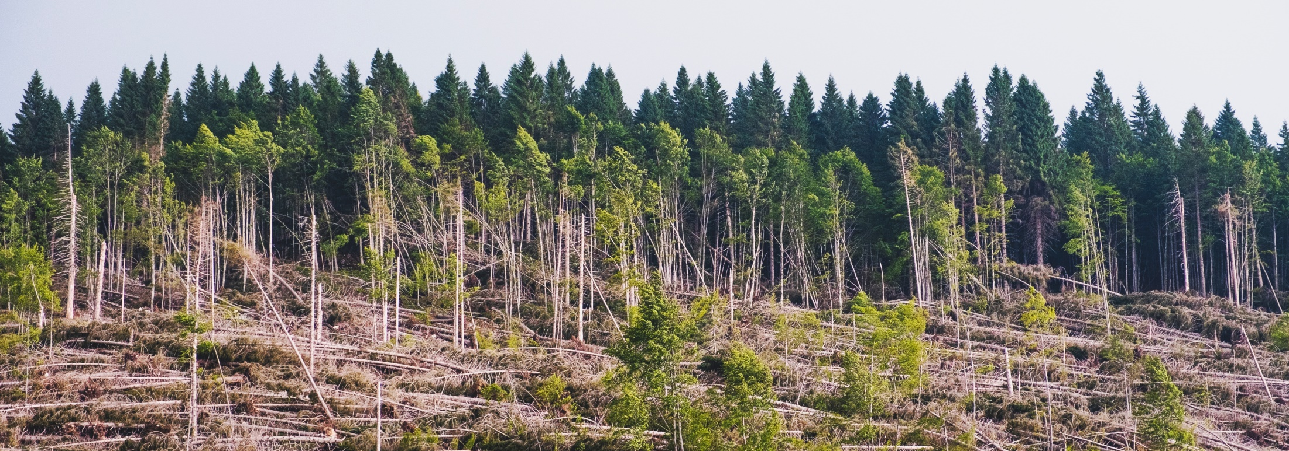

To provide capacity building for leaders and staff of cultural networks on how to claim a role in the action to achieve the climate change goals of the UN SDGs.
ENVIRONMENTAL
SUSTAINABILITY

Slide 3

The urgency
UN SDG 13: Climate action
Target 13.3
Improve education, awareness-raising and human and institutional capacity on climate change mitigation, adaptation, impact reduction and early warning

Slide 4
our Approach
FOCUS:
Cultural networks + potential spill-over effect on cultural sector
STEP 1 | Defining the problem, finding existing resources, exploring the needs
STEP 2 | Creating useful resources specific to cultural networks
STEP 3 | Embracing cultural leadership, kick-starting climate action, implementing change in our organisations
STEP 4 | Working towards long-term effects and spill-over to the sector

Slide 5

PUBLICATIONS ON CLIMATE ACTION
SHIFT ECO GUIDELINES FOR NETWORKS
SHIFT LETTER OF INTENT ON CLIMATE ACTION
SHIFT FACT SHEETS
RESEARCH ARTICLES
ANNOTATED BIBLIOGRAPHY
NEWSLETTER ON LEADING CLIMATE CHANGE
NEWSLETTER ON BEST PRACTICES
COLLECTED RESOURCES ON ENVIRONMENTAL SUSTAINABILITY

Slide 6
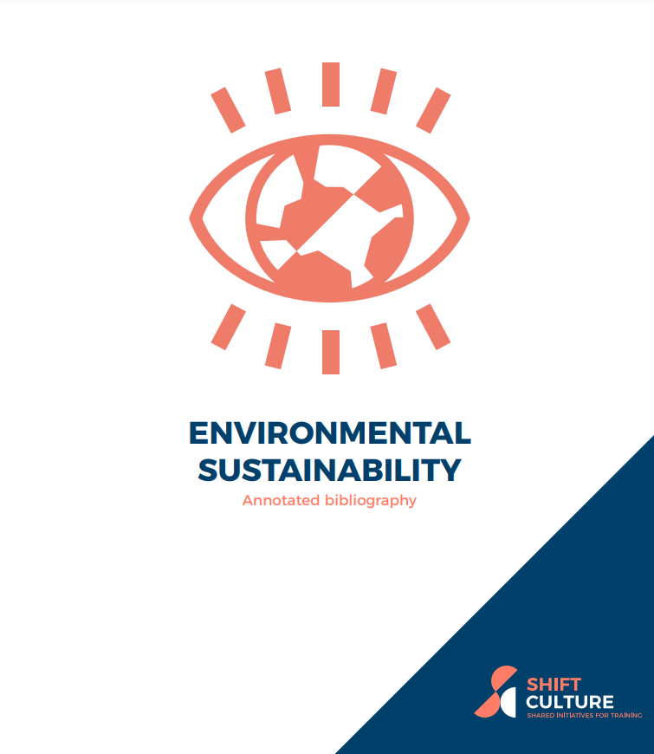
SHIFt CLImate bibliogrAPHY
https://shift-culture.eu/achieve-environmental-sustainability-in-your-work/environmental-sustainability-annotated-bibliography

Slide 7
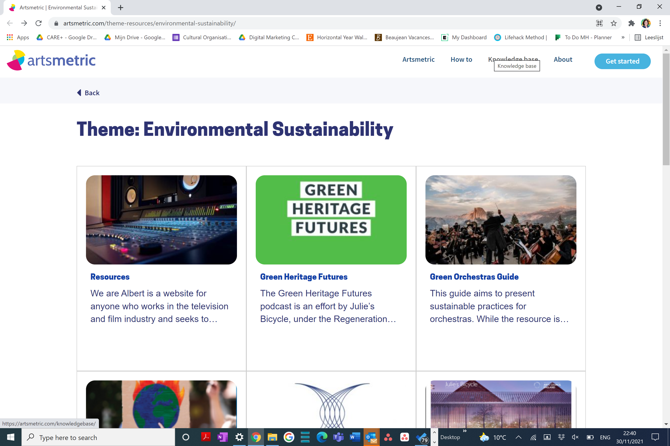

Slide 8
KEY LEARNINGS FROM RESEARCH
Useful action points for organisations:
Environmental policy
Carbon literacy training
Measuring and budget impact
(carbon footprint calculator)
Collaboration
Committing to standards/guidelines
Certification (with audit)

Slide 9
SHIFT Eco-guidelines for networks
Introduction
Chapter 1: Management and Policy
Chapter 2: Communications and Awareness Raising
Chapter 3: Travel
Chapter 4: Events
Chapter 5: Office and Home Office

Slide 10
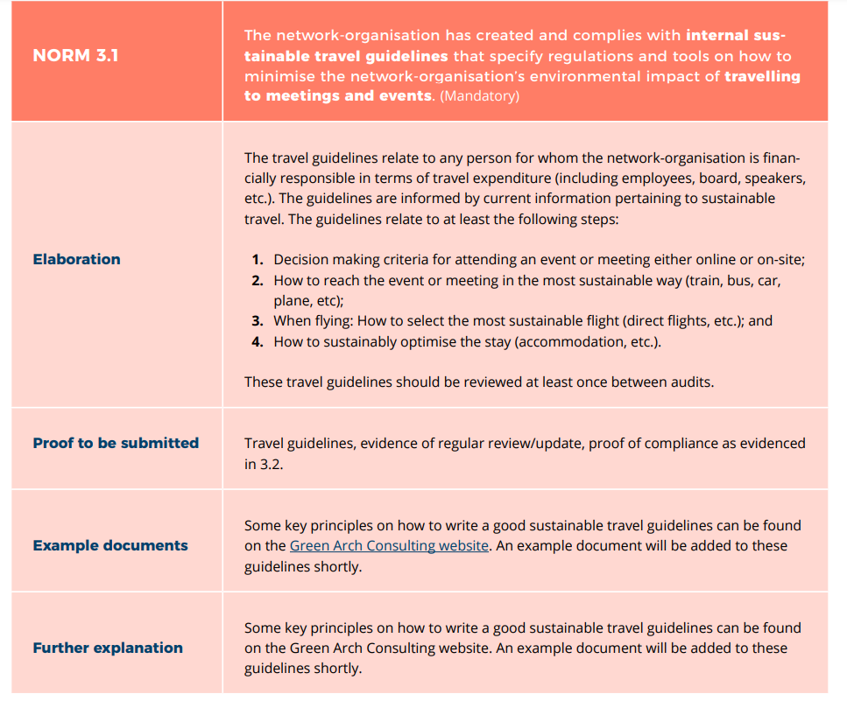
example of norm

Slide 11
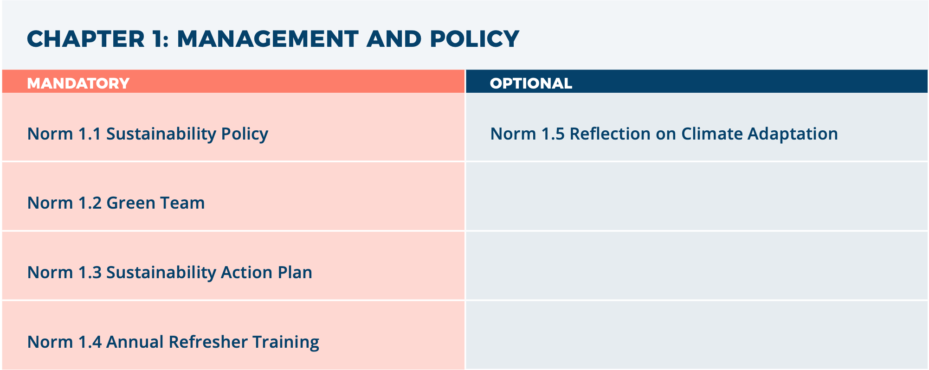

Slide 12
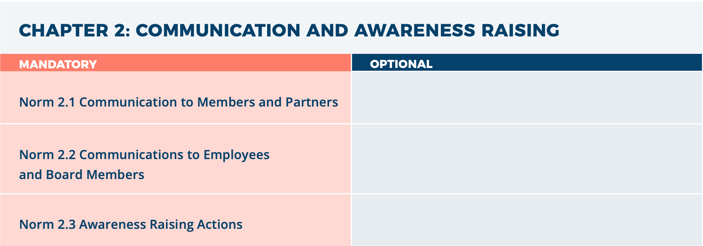

Slide 13
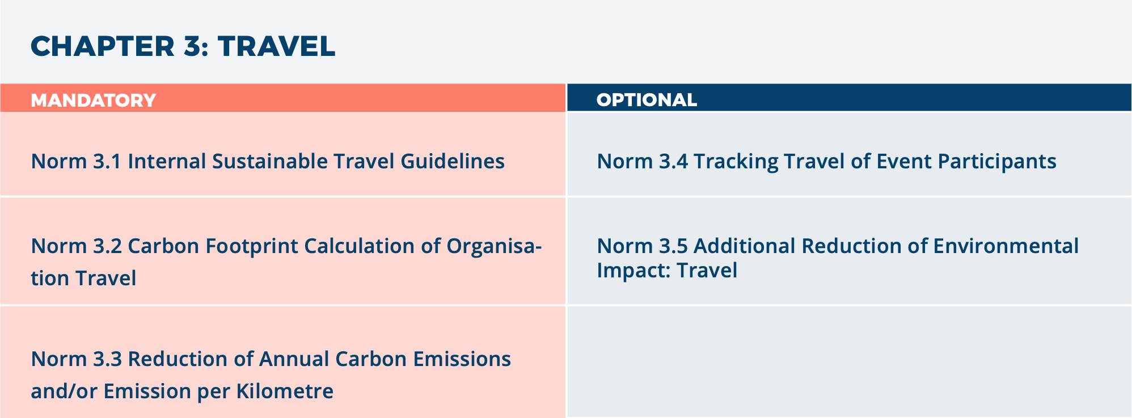

Slide 14
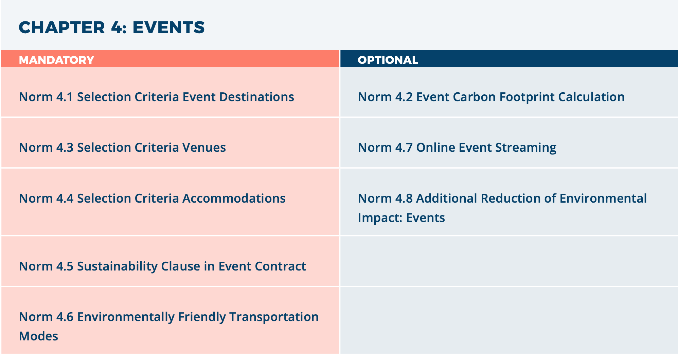

Slide 15
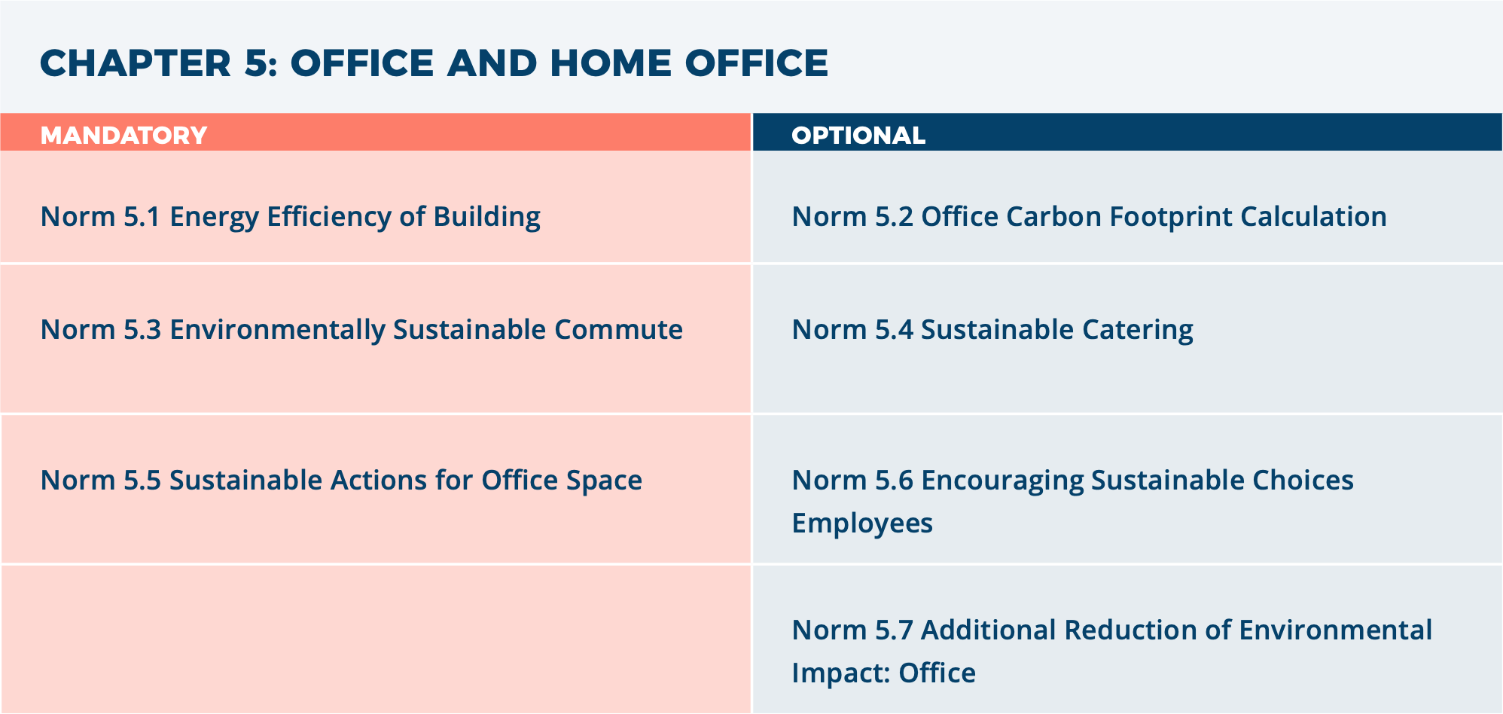

Slide 16
WHAT THE EXPERTS SAY
JULIE’S BICYCLE
“The SHIFT eco-guidelines align perfectly to the climate work that Julie’s Bicycle has championed for more than 15 years. These guidelines will have a strong multiplying effect across the cultural sector, building on a core strength of cultural networks. All of us at Julie’s Bicycle applaud the SHIFT partners for taking the time to develop a custom-made framework that is so easily applicable to other international networks.”
CREATIVE CARBON SCOTLAND
“We were very pleased to be invited to be a ‘critical friend’ on SHIFT Culture’s development of its environmental guidelines. The collaborative leadership demonstrated in the way the SHIFT Culture team has approached this project and the commitment to further development both as separate organisations and a network is very powerful and we look forward to continuing our links with this inspiring initiative.”
GREEN LEISURE GROUP
“By developing and implementing the norms created for a new ecolabel for cultural networks the SHIFT partners have embraced their responsibility of reducing their environmental impact together with their members. Green Leisure Group is proud to have contributed to this process .”

Slide 17










THANK YOU!
TOOLS PRODUCED are Fully available for free online:
www.shift-culture.eu
#shiftcultureplus
Any Questions?
Contact us
Irene.garofalo@elia-artschools.org

Slide 18

ANY QUESTIONS?

