Slide 1
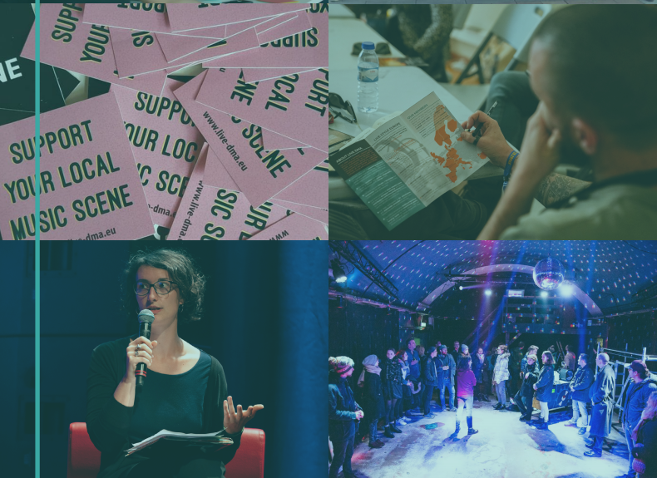

ACTIVITY REPORT 2019

Slide 2
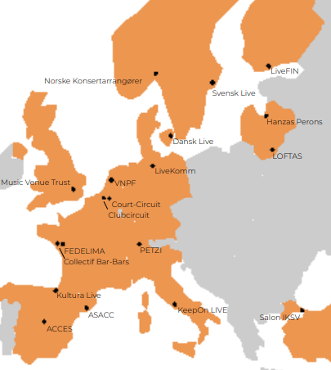
ACTIVITY REPORT – NETWORK’S LIFE
MEMBERS
In 2019, Live DMA counted 19 members in 15 countries representing over 3000 music venues, clubs, and festivals.
Hanzas Perons from Riga, Latvia joined Live DMA as associate member. Hanzas Perons, a former Riga cargo railway warehouse, is now a modern space for culture and art.
NETWORK EVOLUTIONS
Update of long term strategy
Update of ethic charter
Update of membership fee policy
STAFF
Juliette Olivares joins the Live DMA coordination team as project assistant after her six months internship.
MEETINGS
7 online & 3 physical board meetings
1 Survey meeting
1 Annual members meeting

Slide 3
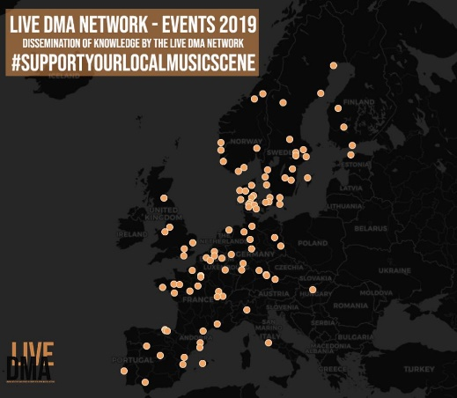
ACTIVITY REPORT – EVENTS
In 2019, Live DMA took part in 22 panels from 18 music festivals and conferences in 9 countries. This map shows also the events that Live DMA members attended.

Slide 4
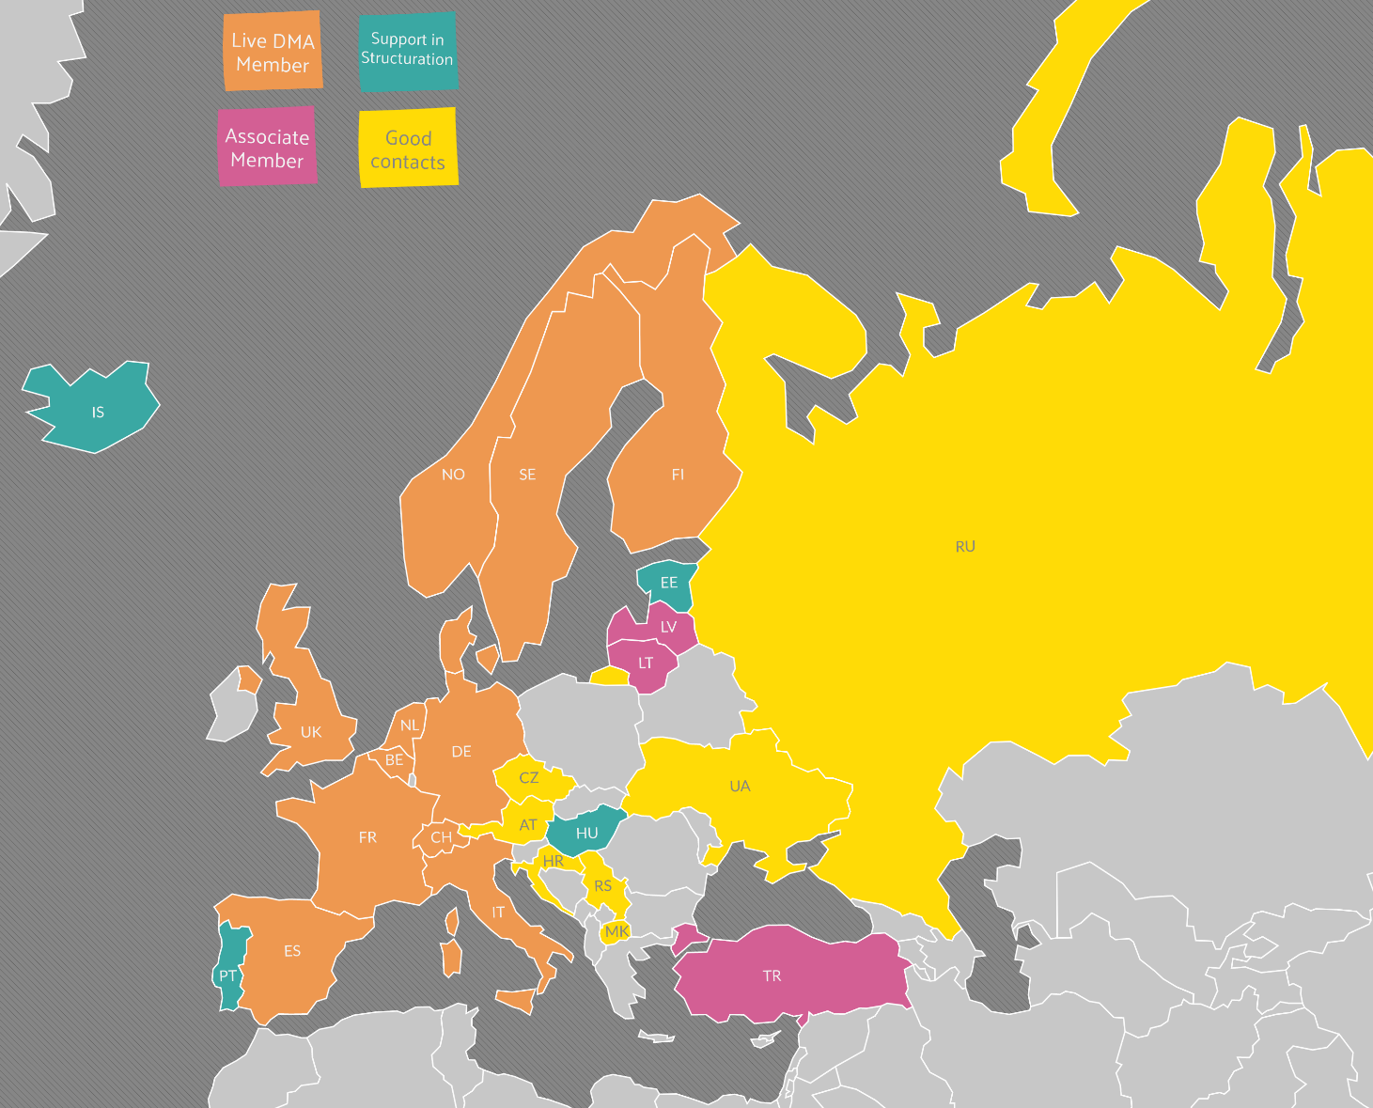
LSE EVERYWHERE – SUPPORTING STRUCTURATION
Live DMA actively supported the structuration and cooperation processes in:
Portugal
Estonia
Hungary
Iceland
In 2019, Live DMA also made new contacts in:
Russia
Ukraine
Czech Republic
Macedonia
Serbia
Croatia

Slide 5

LSE WORLD – THE SURVEY
SURVEY ACTIVITIES IN 2019
All Live DMA members have capable Survey coordinators
Overall increase in the Survey population, response rates and quality of the collected data, as well as more increased communication of data results on regional and national level
14 Live DMA members collected data in 2019
February 2019: Survey coordination meeting in Brussels (10 Live DMA members)
6 Survey presentations at festival conferences & members’ meetings
The Survey report The Survey – Live music venues & clubs in Europe – Facts & Figures was finalized in December 2019 to be published in January 2020

Slide 6


LSE BASICS – RESOURCE PLATFORM
Development of the Resource Platform both in terms of formats and topics:
7 Tools / 6 Publications & Reports / 8 Funding Programmes / 3 Observation studies / 3 Best Practice Initiatives / 7 Live Style Europe Podcasts / 8 Advocacy Statements
www.live-dma.eu
LSE FOR EVERYBODY – WORKING GROUP
MUSIC IS NOT NOISE
2 working group sessions: February 20 & 21, Antwerp, Trix / April 24 & 25, Madrid, Sala 0
Publication: White Paper Music is Not Noise translated into six languages
Resource: Overview of sound regulations in Europe
Tool: Set of recommendations

Slide 7


LSE CONNEXIONS – OPEN CLUB DAY
On the 2nd of February 2019, 120 venues & clubs in 10 countries took part in Open Club Day. This 2nd edition saw the following improvements:
Decentralised coordination: Members became direct interlocutors for the participating venues and clubs
Linguistic plurality: Some members translated elements from the Open Club Day Communication Toolkit
Reinforced online communication: social media, press releases, after-movie…
LSE EVERYWHERE – WHAT ARTISTS SAY
Communication campaign highlighting the role of venues and clubs for talent development
24 artist quotes were collected by 7 members in 6 countries

Slide 8

ACTIVITY REPORT – ADVOCACY & PARTNERSHIPS
CREATIVE EUROPE & MUSIC MOVES EUROPE
Active participation at the Music Moves Europe stakeholder consultations (20th & 21st of May)
Participation at Creative Europe Networks Meetings (17th of June, 21st & 22 of June)
Support to candidates and strong involvement in the dissemination of the Music Moves Europe Preparatory Action “Cooperation of Small Music Venues”
FEASIBILITY STUDY OF A EUROPEAN OBSERVATORY FOR MUSIC
Study coordination: KEA and Panteia // Sept 2018 - Sept 2019
Live DMA is part of the advisory board
Objectives of the study: identify data availability
KEA and Panteia submitted the confidential report to the European Commission in September 2019.

Slide 9


ACTIVITY REPORT – ADVOCACY & PARTNERSHIPS
MUSIC MOVES EUROPE TALENT AWARDS
Award of the European Commission to support emerging European artists
Live DMA is part of the steering committee
Opportunity to take part in a consortium of European music partners
Opportunity for Live DMA members to be part of an artistic project highlighting European values
EUROPEAN MUSIC COUNCIL
Audrey Guerre is a board member of the European Music Council
Participation at the European Agenda for Music Reception at the European Parliament in February 2019

Slide 10
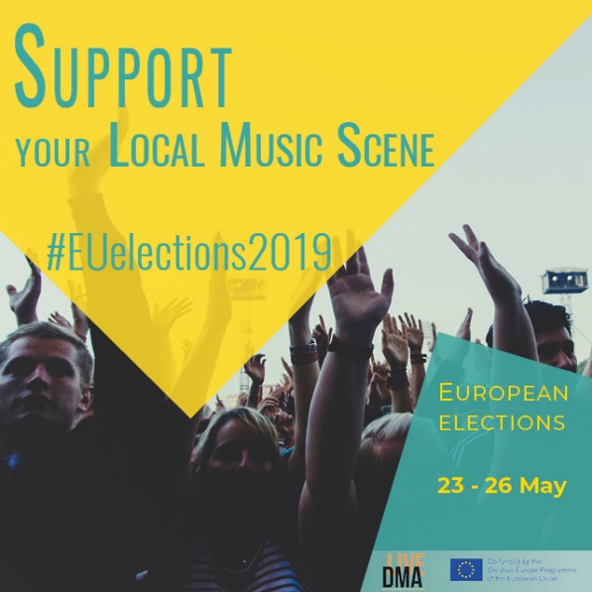
ACTIVITY REPORT – ADVOCACY & PARTNERSHIPS
EUROPEAN ELECTIONS
In May 2019, European Parliamentary elections were held in the European Union. Live DMA took this opportunity to develop a campaign to shed light on the European small and medium-sized music scenes.
The goals of the campaign were:
To affirm Live DMA’s position as stakeholder of the live music sector in Europe;
To assert the network’s values and goals to EU officials;
To advocate for better conditions for live music venues, clubs and festivals in Europe.
This campaign help us get in contact with several Members of the European Parliament and share with them our vision and values with them.

Slide 11
CONTACT
Audrey Guerre
Coordination
audrey.guerre@live-dma.eu
Elisa Thoma
Communication
elisa.thoma@live-dma.eu
Arne Dee
Survey coordination
arne@dee-music.com
Juliette Olivares
Project assistant
juliette.olivares@live-dma.eu
www.live-dma.eu
Tel. +33 7 67 00 59 89
Tel. +33 7 81 38 39 88
Facebook | Instagram | Twitter | LinkedIn

